Slide 1
Data Protection Notice
The Network for East Anglian Collaborative Outreach (neaco) is a project aimed at increasing the number of young people going into Higher Education. neaco consists of the University of Cambridge (including its Colleges), Anglia Ruskin University, the University of East Anglia, Norwich University of the Arts, and the University of Suffolk.
Take Your Place is the programme which is being run by neaco in schools and colleges in East Anglia. Information about how your personal information will be used by us in connection with the administration of the Take Your Place programme, and for related purposes, is available at https://www.takeyourplace.ac.uk/how-we-use-participant-data.
We will also get in touch by email to facilitate your involvement in the Take Your Place programme. Please contact info@takeyourplace.ac.uk if you have any questions about how we use your data.
Explore your options,
Discover your potential
takeyourplace.ac.uk

Slide 2
Explore your options,
Discover your potential
Keeping interested and getting inspired in Engineering
takeyourplace.ac.uk

Slide 3
How can we help?
This PowerPoint is here to provide you with different ideas to help and support you with writing a Personal Statement for an Engineering course at University.
We have put together reading lists, preparation ideas and top tips for the application process for university.
You might not be able to do any practical work experience before you apply to university, but you can gain an insight into the world of Engineering in lots of other ways.

Slide 4
Where do I start?!
Lets start with some reading. We recommend using this time to do some further reading on your chosen subject, as it is important that your personal statement contains an academic paragraph.

Slide 5
An Academic Paragraph
Having an academic paragraph in your personal statement is really important and we suggest using the following reading lists to help. You can use this paragraph to analyse a small piece of text from a relevant book/journal, article or performance.

Slide 6
What type of Engineering?
Traditionally engineering was divided into four main categories; chemical, mechanical, civil and electrical engineering.
Engineering is a fast-moving industry and new types of engineering are emerging all the time.
Use this time to research the different types of engineering and think about which suits you.
https://mtfy.tomorrowsengineers.org.uk/

Slide 7
What type of Engineering?
Aerospace engineering
Agricultural engineering
Audio engineering
Automotive engineering
Biomedical engineering
Broadcast engineering
Computer engineering
Design engineering
Energy engineering (from petroleum to alternative fuels)
Environmental engineering
Food science engineering
Geological and geophysical engineering
Maintenance engineering
Manufacturing engineering
Marine engineering
Materials engineering
Mining engineering
Nanoengineering (engineering on a tiny scale with components as small as several atoms)
Nuclear engineering
Rail engineering
Structural engineering

Slide 8
Reading suggestions
Sustainable Energy – Without the Hot Air by David J.C. MacKay
How Do Wings Work? by Holger Babinsk
Sustainable Materials – With Both Eyes Open by Julian Allwood and Jonathan Cullen
Engineering in Society edited by Rob Lawlor
Engineering: A Beginner's Guide by Natasha McCarthy
The Essential Engineer: Why Science Alone Will Not Solve Our Global Problems by Henry Petroski
Think Like An Engineer by Guru Madhavan

Slide 9
TED Talks
TED Talks by Engineering Staff at Cambridge University
Professor Julian Allwood: "Let's just use less energy"
Dr Tim Minshall: "Building the Future"
Dr Tim Minshall: "Engineering in a connected world"
Dr Tim Minshall: "How 3D printing is enabling the '4th Industrial Revolution'"
Professor Rodolphe Sepulchre: "Do brains compute?"
Professor Daniel Wolpert: "The real reason for brains"

Slide 10
Websites to inspire and inform you
https://i-want-to-study-engineering.org/
https://www.smallpeicetrust.org.uk/
https://www.jamesdysonfoundation.co.uk/
https://eandt.theiet.org/
https://www.ice.org.uk/what-is-civil-engineering
https://www.istructe.org/become-a-structural-engineer/how-to-become-a-structural-engineer/
https://www.raeng.org.uk/
https://www.womeninstem.co.uk/#
https://www.ucas.com/explore/subjects/engineering-and-technology

Slide 11
More inspiration
The Engineering sector has embraced Degree Apprenticeships.
Register with https://www.apprenticeships.gov.uk/ to find out more.
https://www.engineering.gov.uk/video
https://eng.ox.ac.uk/outreach/support-during-school-closures/
Try a FREE short online course with Open Learn
https://www.open.edu/openlearn/free-courses/full-catalogue

Slide 12
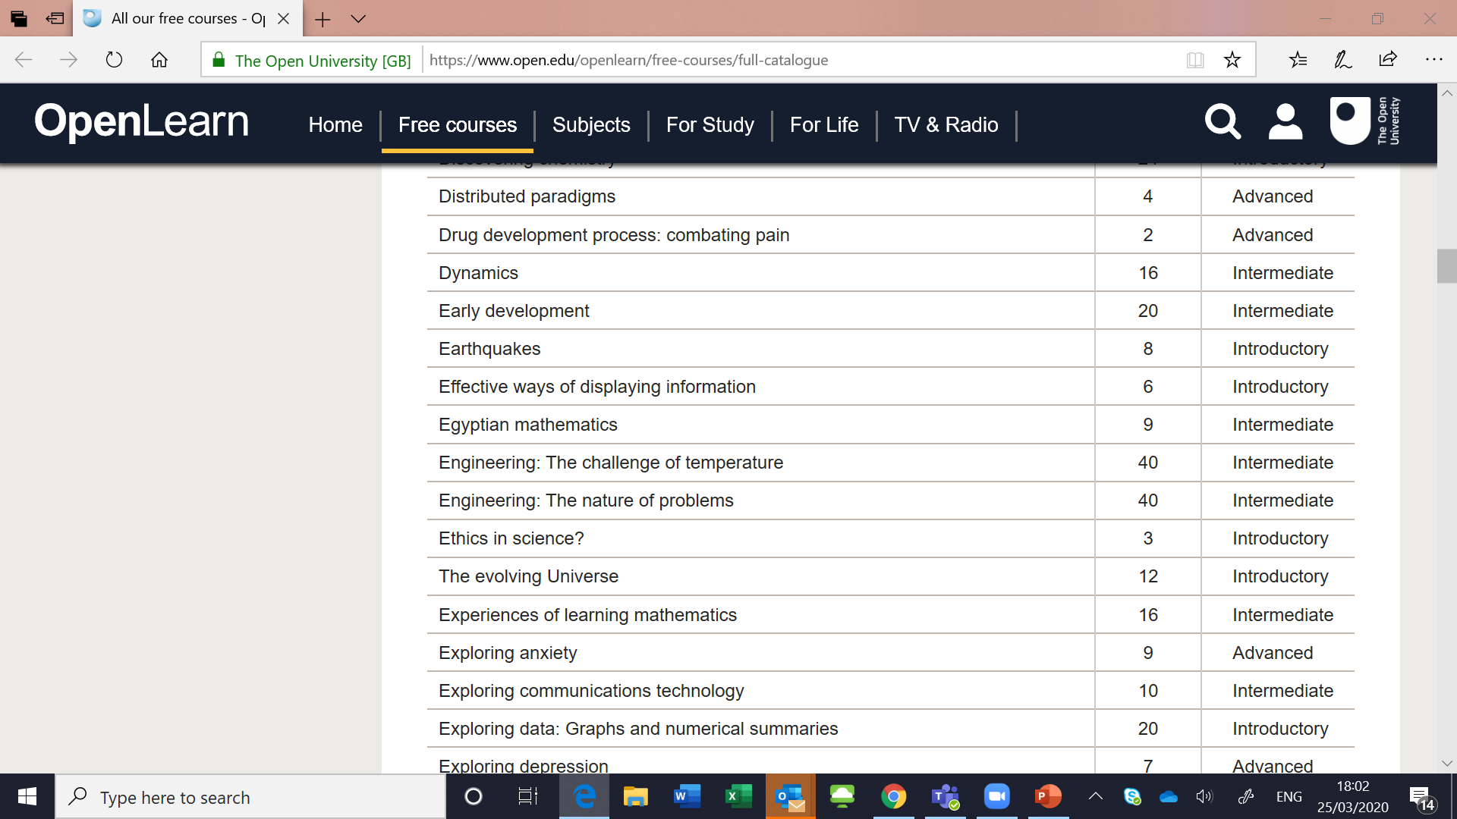
Try an online course for FREE!

Slide 13
Engineering Jobs
For more information about the types of jobs available in Engineering check out:
https://www.tomorrowsengineers.org.uk/real-jobs/
https://www.youthehttps://www.tomorrowsengineers.org.uk/real-jobs/mployment.org.uk/different-types-engineering-careers-available-today/

Slide 14
Make the most of now
We are living through History!
The coronavirus is already having and will continue to have a massive impact on the global economy.
Keep an Engineering focused diary of the events as they happen and take note of any engineering solutions – car manufacturers changing to ventilator production for example.

Slide 15
My HE+
Thinking about applying to University and looking for ways to explore your subject beyond the curriculum? Then this website is for you. Each topic is produced by Cambridge postgraduate students and academics at the cutting edge of research in their field. The topics provide guided activities, questions to think about and suggestions for further reading.
The main subject pages also give you a quick guide to what it would be like to study the subject at university level and suggest some further resources to check out.
https://www.myheplus.com/

Slide 16
Find Us Online:
www.TakeYourPlace.ac.uk
Cambs@TakeYourPlace.ac.uk
https://www.facebook.com/TakeYourPlaceHE
@TakeYourPlaceHE
@TakeCambs

